Slide 1

Presentation Of Project Based Learning
CS 14.204
Database Management System
Submitted by:
NISTHA AGARWAL (170425)
Guided by:
Dr. Pinaki Ghosh
B Tech-II (2018-19)
CSE (IS) - B2

Slide 2
Pbl project on Home tuition system

Slide 3
INTRODUCTION
The project is aiming for development of home tuition system for the students of any age group by the college students. This project aims at providing benefits to both learners and tutor by giving employment and managing skills to college students who can explore their knowledge as a tutor and ease for the students by getting knowledge from the people of same age group at their place.
So, a Tuition Management System ease the work of both tutors and learners. All the required information can be obtained at single place. This home tuition system allows you to manage a large number of students every day. Monitoring the presence of students and other personal information. This project aims to develop an online home tuition management system that provides the necessary and easy way to manage information daily.

Slide 4
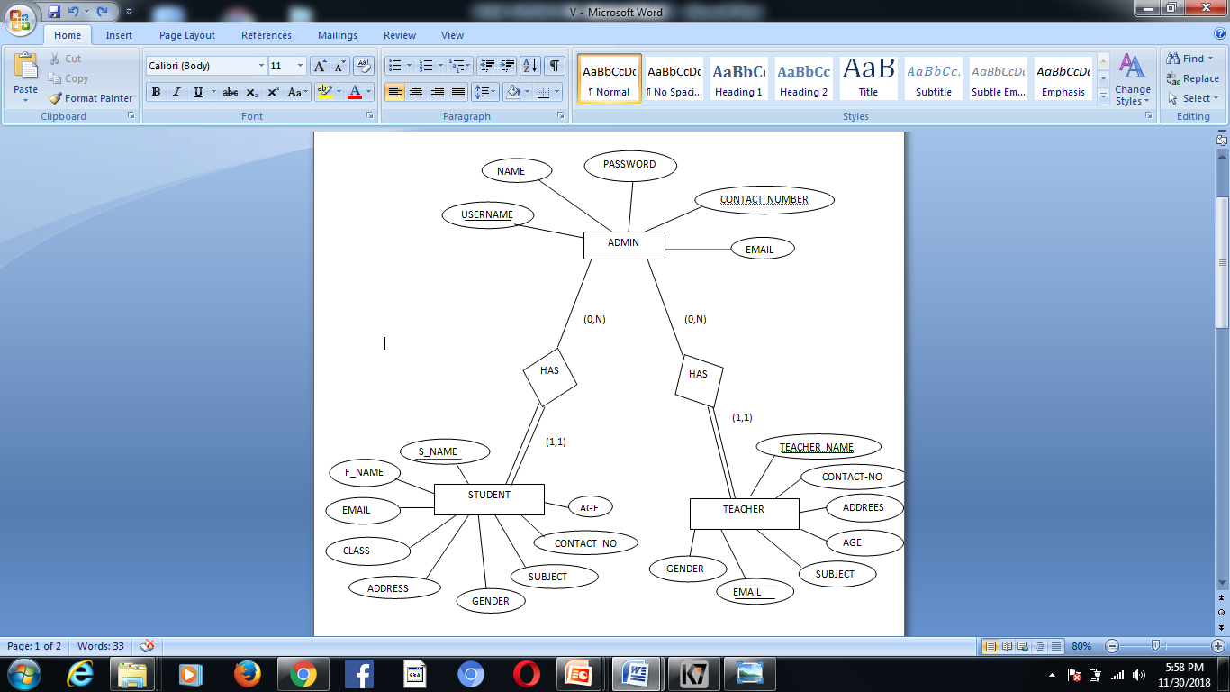
E
R
D
I
A
G
R
A
M

Slide 5
ABOUT E-R DIAGRAM
In the admin entity, we cover the department like human resource, accounts and owner. The people who are working will have the staff id for the identification which will have a more privileges than the employee has.It will cover the following attributes: Username, Password, Name, contact number, email.
The teacher entity is directly related to administrator. Every administrator can have one more teacher. It has following attributes: tutor_name, tutor_id, age and amny more
The students are the client who will register through the website and further have an option to enroll themselves in a course and confirm their registration by paying the fee. It has following attributes: stud_id, stud_name, fathers name, email id and amny more.

Slide 6
TOOLS AND TECHNIQUES USED
Language and database combination will allow the best
performance as well as the required security are:
NetBeans: NetBeans is an integrated development environment (IDE) for Java. With NetBeans, applications can be developed from a range of modular software components known as modules. NetBeans runs on Microsoft Windows, Mac OS, Linux and Solaris. In addition to Java development, there are extensions for other languages ​​such as PHP, C, C ++, HTML5 and Javascript. NetBeans-based applications, including the NetBeans IDE, can be extended by third-party developers.
MySQL: MySQL is by far the most popular database management system for small to medium web projects. Only the proprietary Oracle database and the small embeddable SQLite are being distributed. MySQL is by far the most popular database management system for small to medium web projects.

Slide 7
Only the proprietary Oracle database and the small embeddable SQLite are being distributed. A database is a place where data of various types can be stored for later retrieval. You can vary in size from a single table to large collections of tables with millions of tuples and columns.
JDBC connector:
The Java Database Connectivity (JDBC) Connector is a program that allows Java application servers running on the Sun Microsystems Java 2 platform, Enterprise Edition (J2EE), to access different databases. The JDBC Connector connects an application server to a JDBC driver. With the connector, driver providers can pack drivers to be plug-and-play with J2EE applications. In addition, application ser

Slide 8
THANK YOU!!

